Slide 1
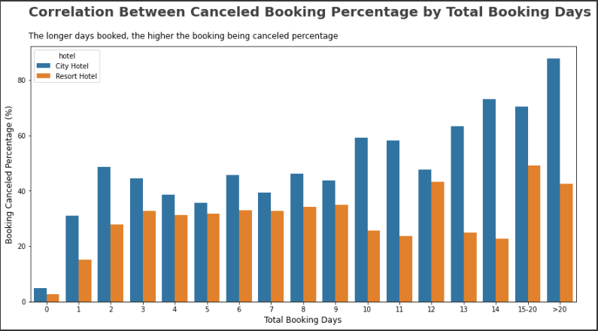
Impact Analysis of Stay Duration on Hotel Bookings Cancellation Rates
The longer the booking days, the higher the canceled in both hotel type
City hotel type has steeper rising trend compared with resort hotel type
In 2-9 booking days, the cancellation trend seems relatively stagnant in both hotel type

